Slide 1
Temperature and humidity sensor

Slide 2

Aim :-
The aim of this project is to develop a real-time humidity and temperature monitoring system using Arduino, DHT11 sensor, and I2C LCD display for efficient environmental data tracking.

Slide 3

Introduction
A temperature and humidity monitoring system is a vital tool designed to continuously measure, record, and manage the temperature and humidity levels in an environment. These systems are essential for maintaining optimal conditions in various applications, including agriculture, healthcare, industrial processes, and smart homes. By leveraging sensors and modern technologies, these systems ensure environmental stability, prevent potential damages, and improve efficiency. Temperature and humidity are critical factors that influence the quality, safety, and functionality of numerous processes and products. Unregulated fluctuations can lead to spoilage of goods, equipment malfunctions, or compromised safety standards. Monitoring systems provide real-time data, early warnings, and automated controls to address such challenges effectively.

Slide 4
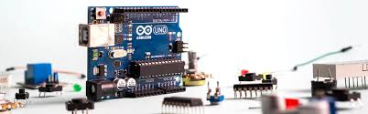
Apparatus required:-
Arduino smd
- Sensors: DHT11/DHT22 (for temperature and humidity).
- Microcontroller: Arduino/ESP32/Raspberry Pi.
- Display: LCD/LED screen (optional).
- Power Supply: USB or battery.
- Software: Arduino IDE or custom software.

Slide 5
objectives
The objectives of a temperature and humidity monitoring system depend on its application but generally aim to maintain environmental conditions, ensure safety, and improve efficiency. Here are the key objectives:
1. Ensure Optimal Environmental Conditions
Maintain specific temperature and humidity levels required for sensitive environments like greenhouses, laboratories, or data centers.
2. Protect Assets and Equipment
Prevent damage to equipment, materials, or goods caused by extreme temperatures or humidity.
Ensure longevity of machinery, electronics, or perishable items.
3. Enhance Safety
Monitor environments to prevent health hazards (e.g., heat stress, mold growth, or contamination in food storage).
Provide timely alerts for dangerous conditions, such as overheating or excessive moisture.
4. Improve Process Efficiency
Ensure consistent environmental conditions for optimized production in industries such as pharmaceuticals, food processing, and manufacturing.
Reduce downtime by preventing environmental disruptions.

Slide 6
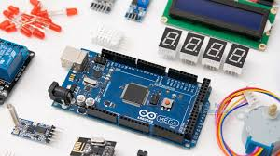
Arduino Uno:-
ATmega328 is commonly used in many projects and autonomous systems where a simple, low-powered, low-cost micro-controller is needed.

Slide 7

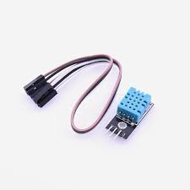
DHT11:-
"DHT11 is a low-cost digital temperature and humidity sensor renowned for its simplicity and reliability, making it popular for weather monitoring and home automation projects."

Slide 8
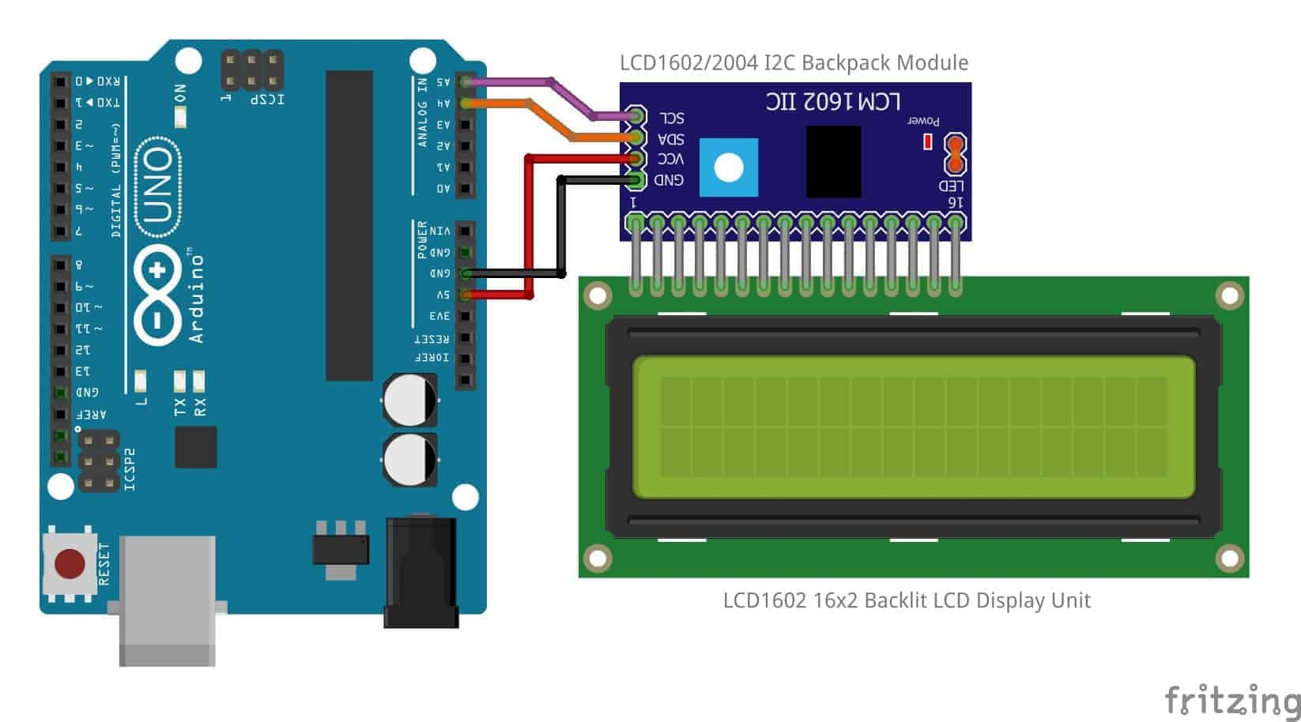
Liquid_Crystal:-
I2C_LCD is an easy-to-use display module, It can make display easier. Using it can reduce the difficulty of make, so that makers can focus on the core of the work.

Slide 9
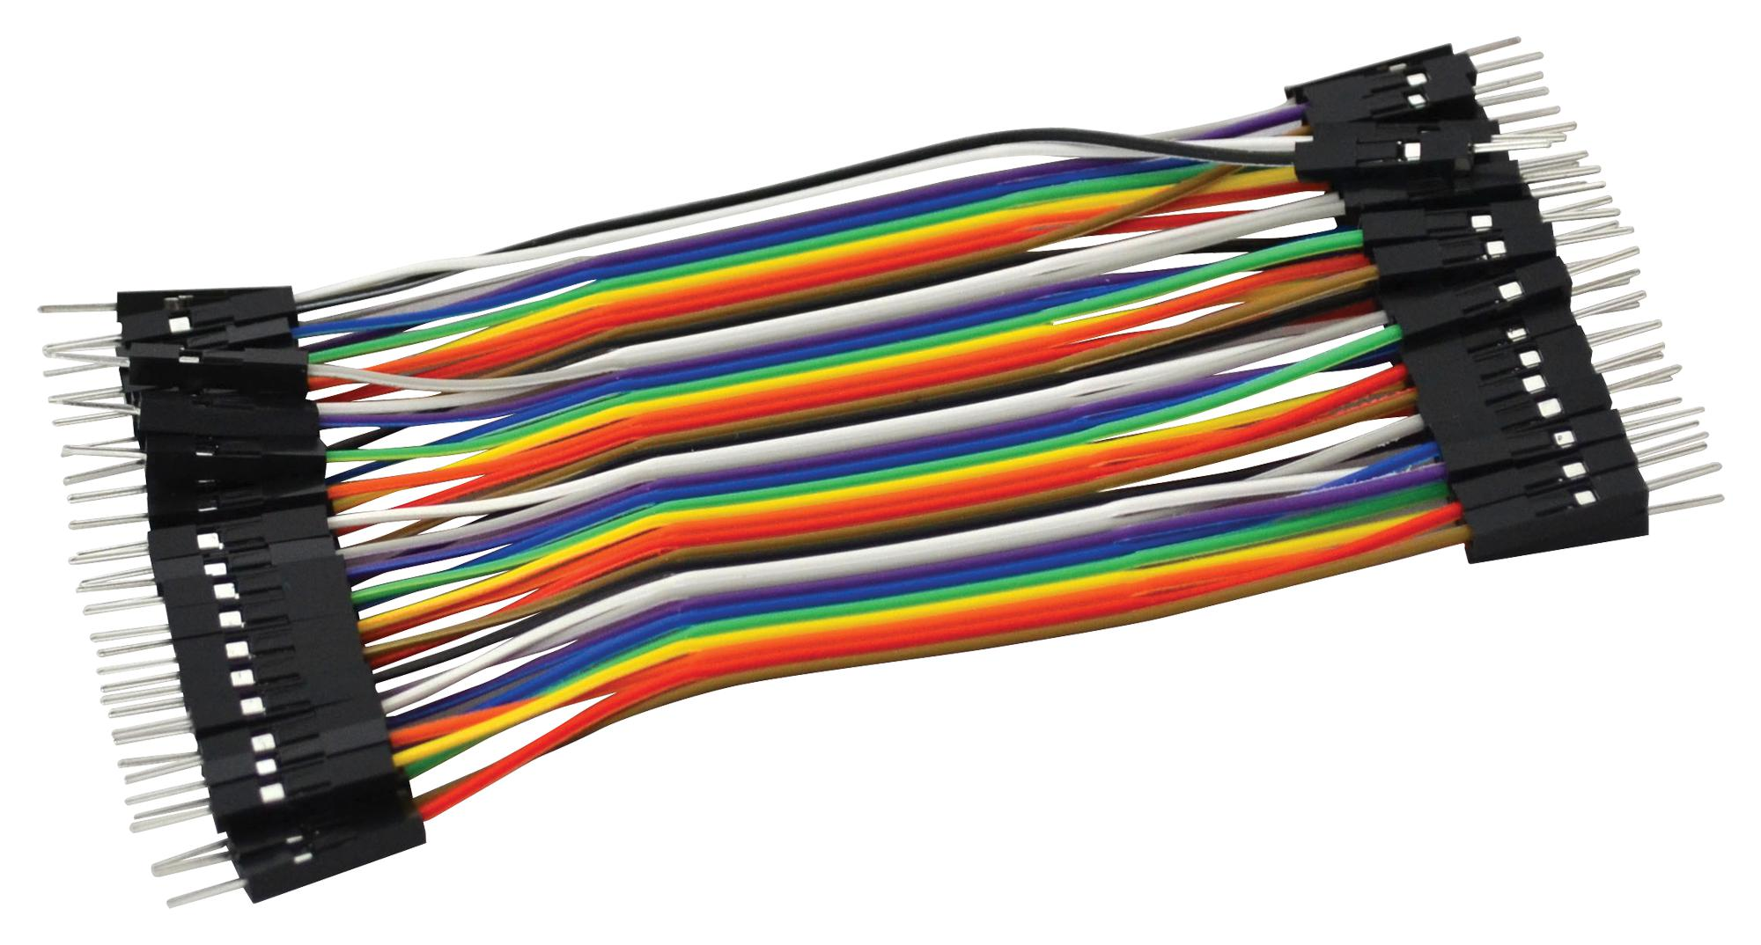
Jumper wires:-
A jumper wire is an electric wire that connects remote electric circuits used for printed circuit boards.

Slide 10
Working Principle
The working principle of a temperature and humidity monitoring system involves sensing, processing, and communicating environmental data. Here's a step-by-step breakdown:
1. Sensing
The system uses temperature sensors (e.g., thermistors, thermocouples, or digital sensors like DS18B20) to measure the ambient temperature.
Humidity sensors (e.g., capacitive or resistive humidity sensors like DHT11 or DHT22) measure the moisture content in the air.
These sensors convert physical quantities (temperature and humidity) into electrical signals.
2. Signal Conditioning
The raw signals from the sensors are often weak and need amplification or noise filtering.
Analog-to-digital converters (ADCs) may be used if the sensors produce analog signals, converting them into digital data for further processing.
3. Data Processing
A microcontroller or microprocessor (e.g., Arduino, Raspberry Pi) processes the sensor data.
The system may compute averages, apply calibrations, or detect anomalies in real-time.
4. Display and Alerts
The processed data is displayed on an interface, such as an LCD screen, mobile app, or computer dashboard.
If conditions deviate from preset thresholds, the system triggers alerts via LEDs, alarms, or notifications.
5. Communication
Modern systems use wireless communication protocols (e.g., Wi-Fi, Bluetooth, or LoRa) to transmit data to remote devices or cloud servers.
Data can be logged for analysis or integrated with other systems for automation.

Slide 11
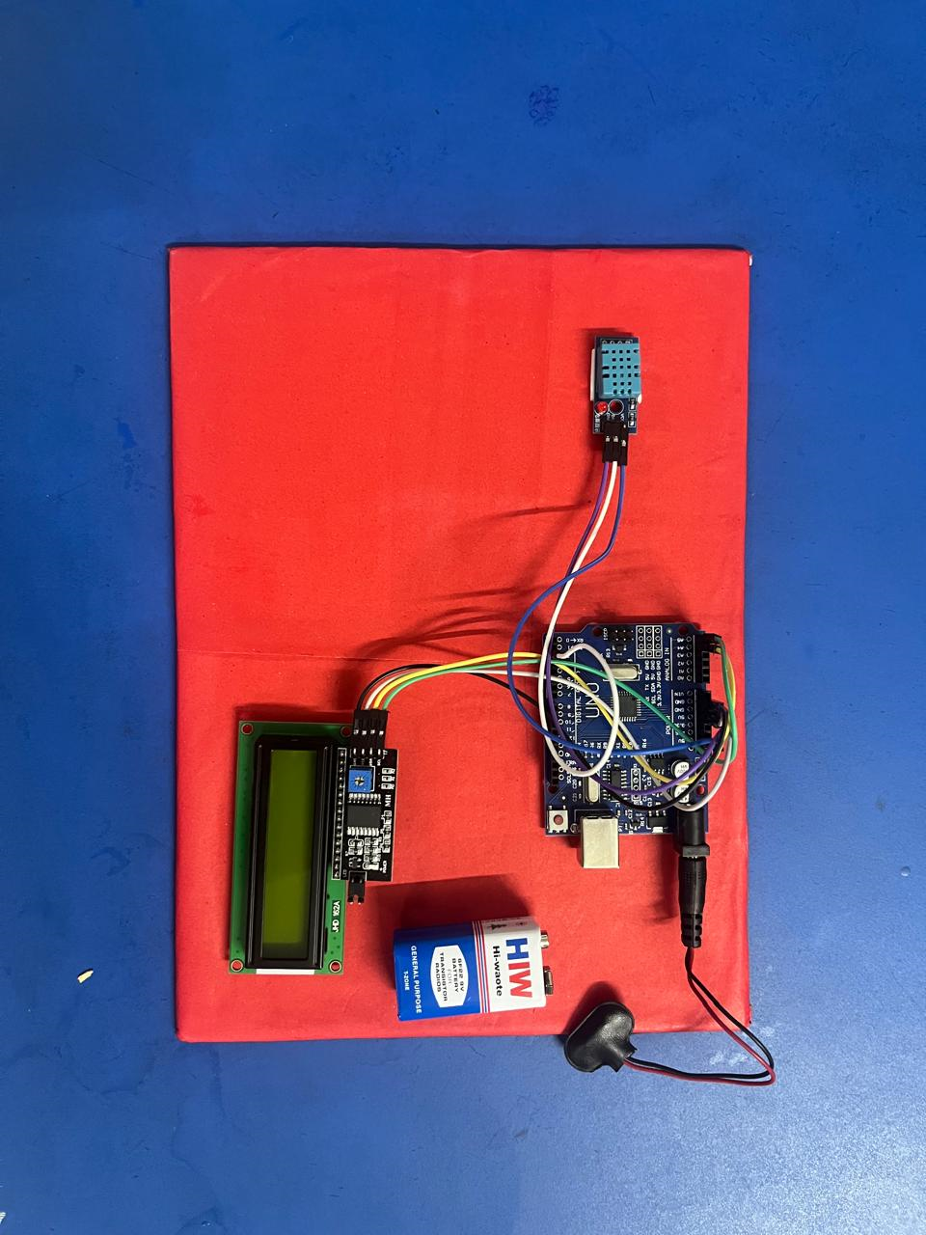

Slide 12
application
Healthcare and Pharmaceuticals
Vaccine Storage: Ensures proper conditions in refrigerators and cold chains to maintain vaccine efficacy.
Laboratories: Monitors controlled environments for experiments and chemical storage.
Hospitals: Tracks conditions in operating rooms, patient wards, and equipment storage areas.
Food and Beverage Industry
Cold Storage: Maintains the quality of perishable goods like dairy, meat, and produce.
Processing Facilities: Ensures compliance with food safety standards during production.
Restaurants and Retail: Monitors storage and display units for fresh and frozen goods.
Agriculture and Horticulture
Greenhouses: Tracks and controls temperature and humidity for optimal plant growth.
Livestock Farming: Maintains suitable conditions in barns to ensure animal health.
Crop Storage: Prevents spoilage by monitoring grain silos and produce warehouses.

Slide 13
Conclusion
Temperature and humidity monitoring systems provide real-time data critical for maintaining ideal conditions, ensuring product quality, enhancing comfort, and preventing damage. By leveraging advanced sensors, IoT technologies, and automated controls, these systems ensure efficiency, accuracy, and timely alerts for deviations. Integrating these systems with data analytics can further enhance decision-making, predictive maintenance, and energy savings. Their importance continues to grow in modern applications, where environmental control is paramount for sustainability and performance

